Slide 1

Bank Marketing Dataset - Classification
GROUP 16:
AMITESH TRIPATHI JAIMEEN UNAGAR MEET VASANI ROHIT KUMAR GADDAM SRINIVAS MURALI

Slide 2

Problem Statement
We are provided a dataset from a Portuguese bank. The bank has a product (term deposit) that it wants its customers to sign up for. The dataset includes client information, information about past contacts in the current campaign, information about social and economic situations at the time, and other information. The bank would like to know which customers are most likely to sign up for a term deposit.

Slide 3

Objective
The project intends to improve a bank's marketing strategy and increase revenue by predicting whether a consumer would subscribe to a bank's term deposit plan. By evaluating which customers are most likely to sign up for a term deposit, the bank may better target its marketing efforts.

Slide 4
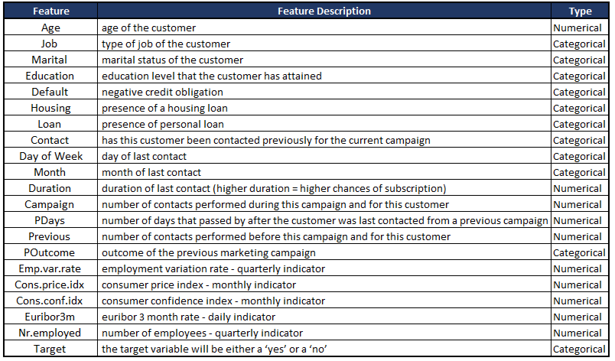
About the Dataset
The dataset is related to direct marketing campaigns (phone calls) of a Portuguese banking institution. These marketing campaigns were based on phone calls, often requiring more than one contact to the same client to assess if the bank product (term deposit) would be subscribed. The dataset provides a rich set of features including bank client data, attributes related to the last contact in the current campaign, and social and economic context attributes.
The dataset consists of
41188 row
20 features and one target variable
Out of the 20 features, 10 are categorical and other 10 are numerical.

Slide 5

Exploratory Data Analysis

Slide 6
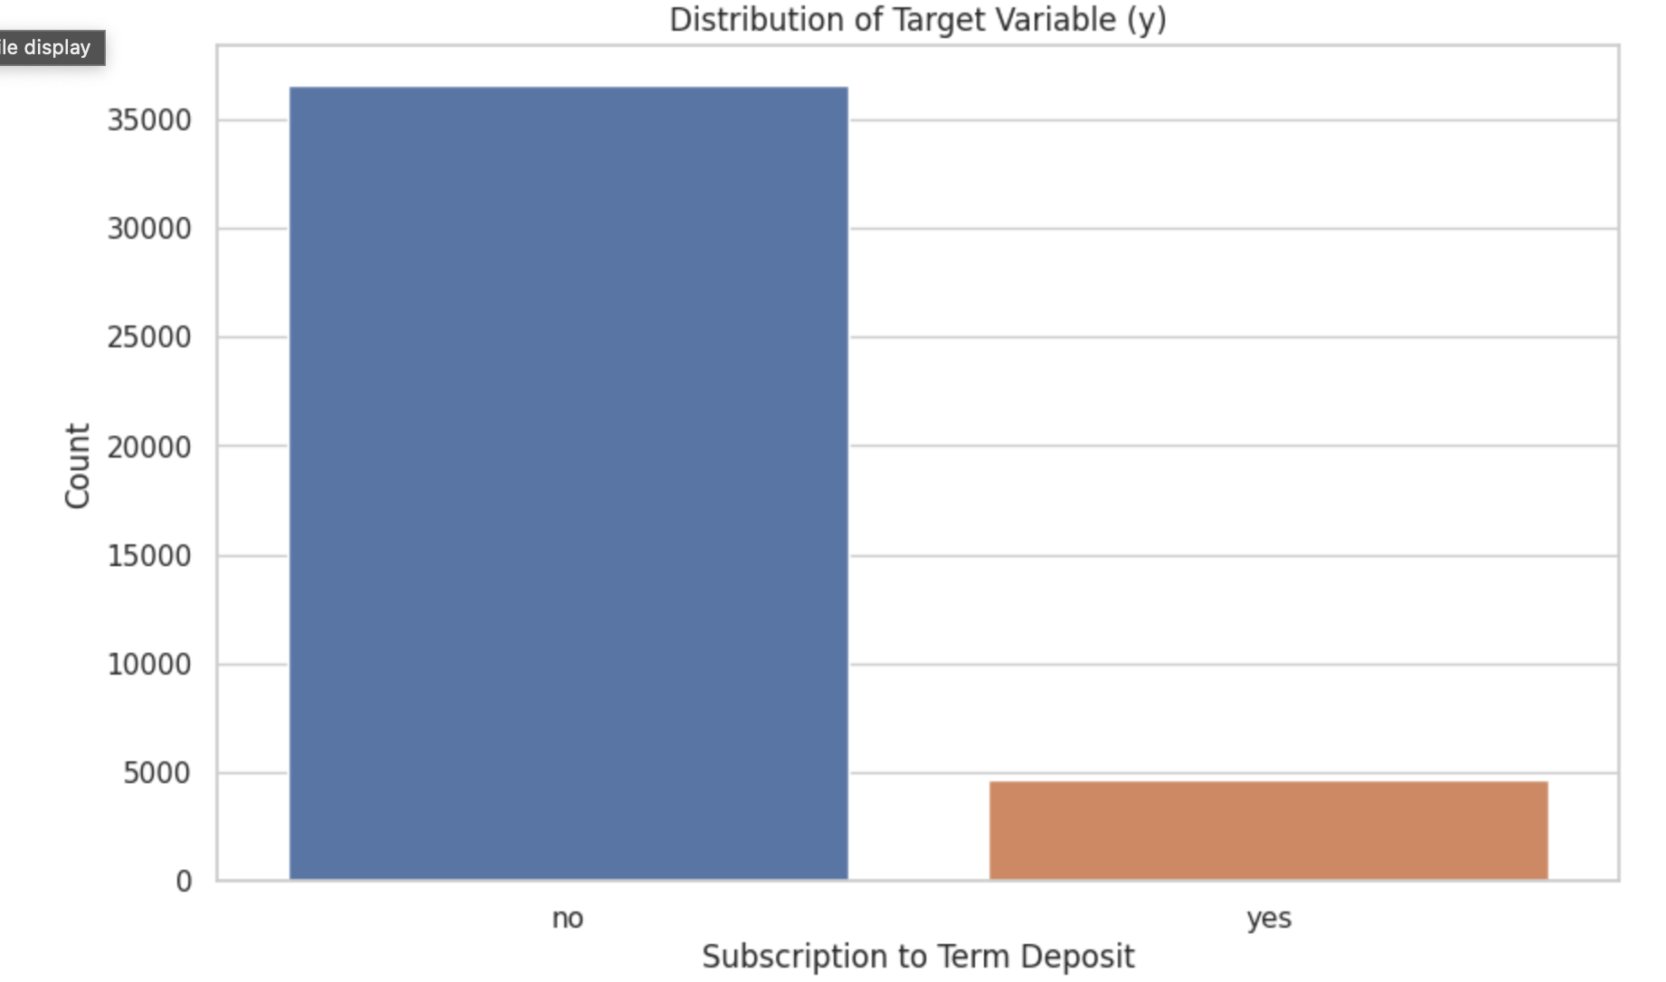
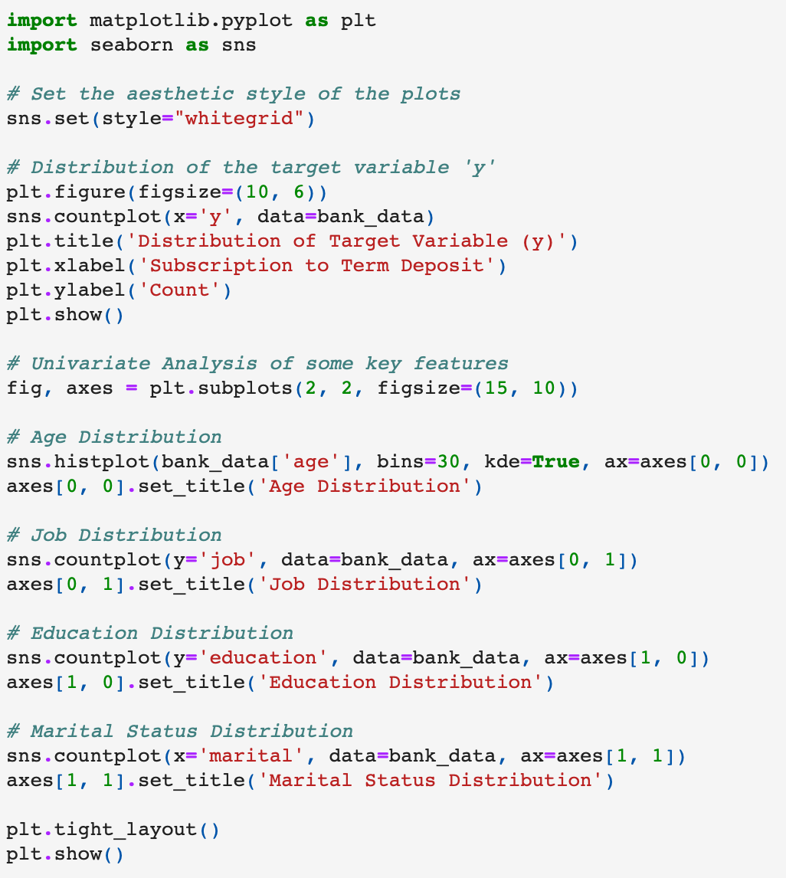
Distribution of Target Variable (y)

Slide 7
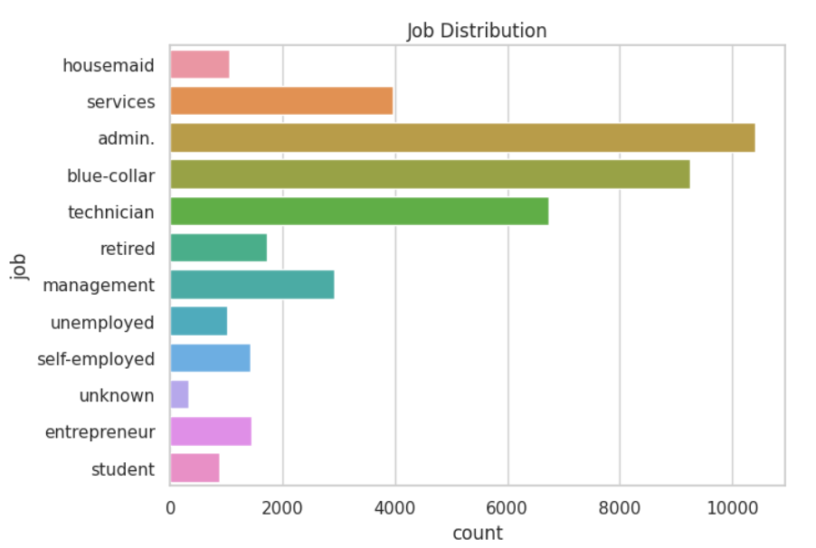
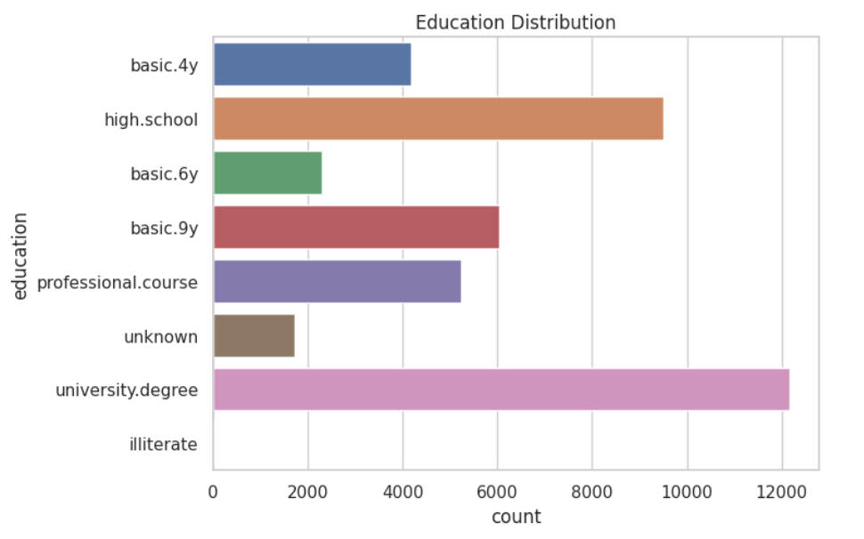
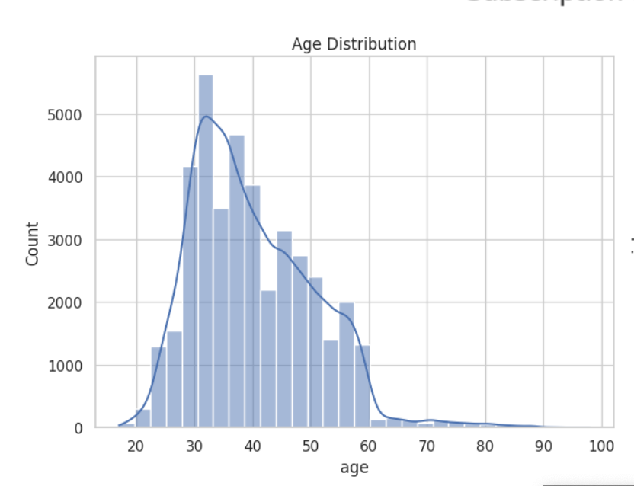
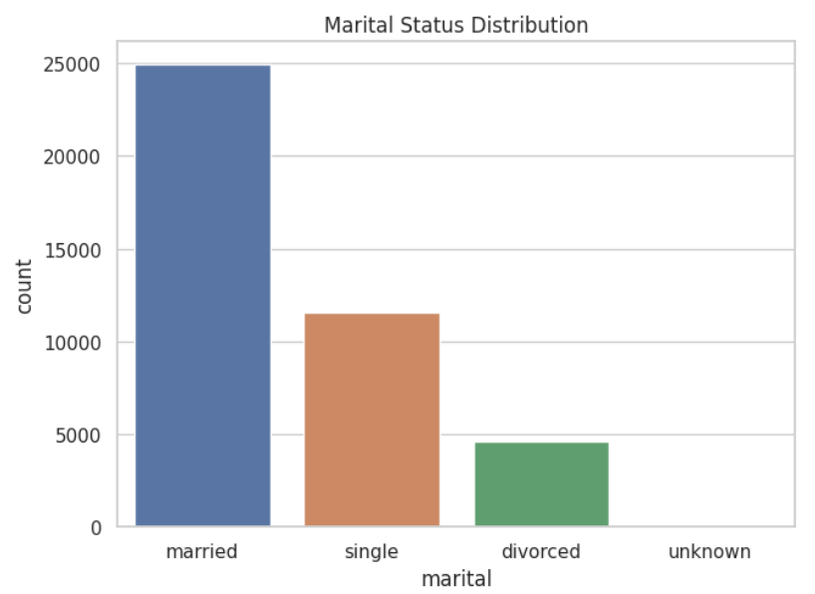
Univariate Analysis

Slide 8
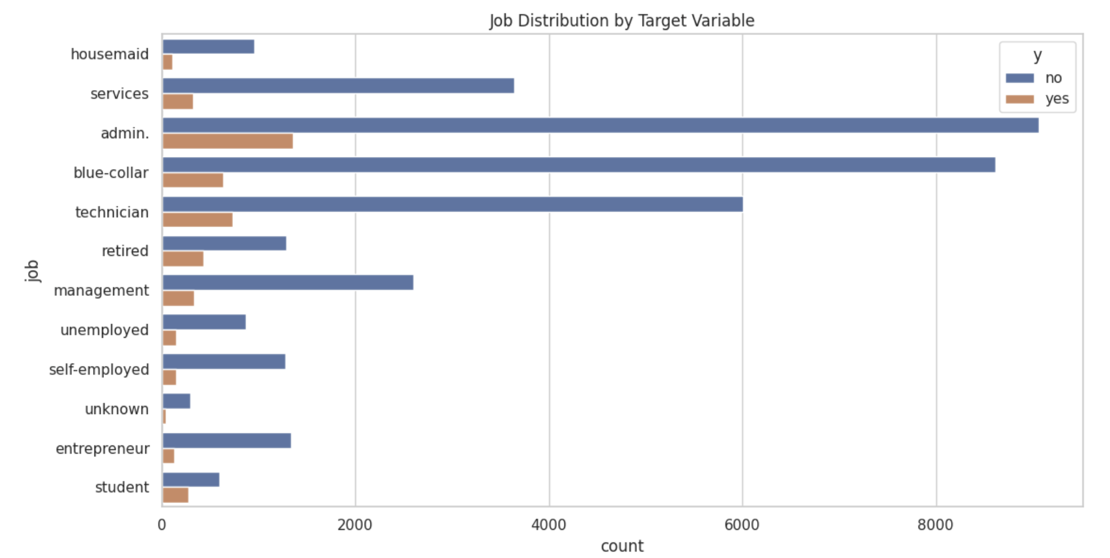
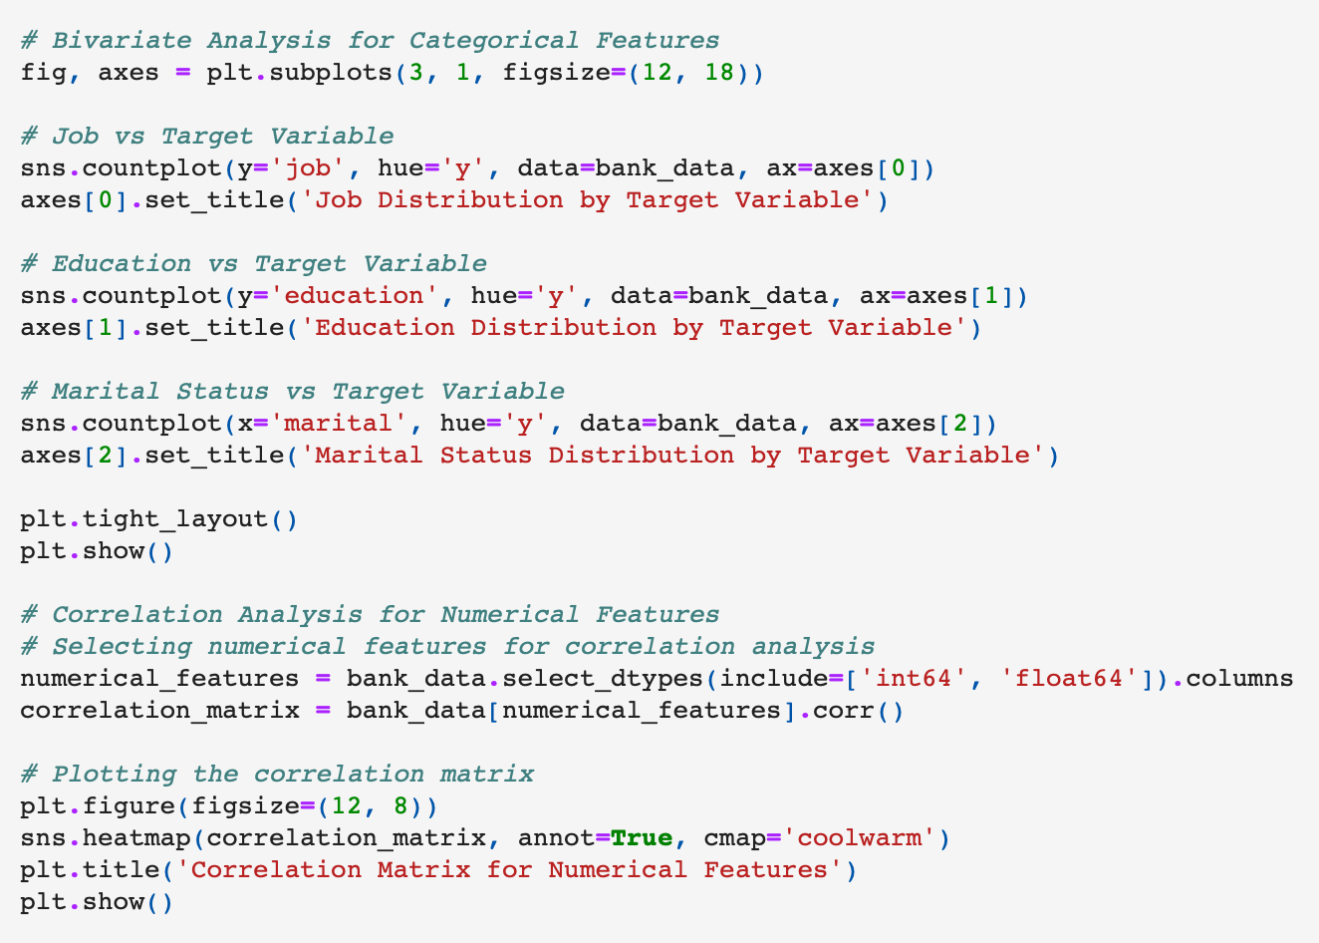
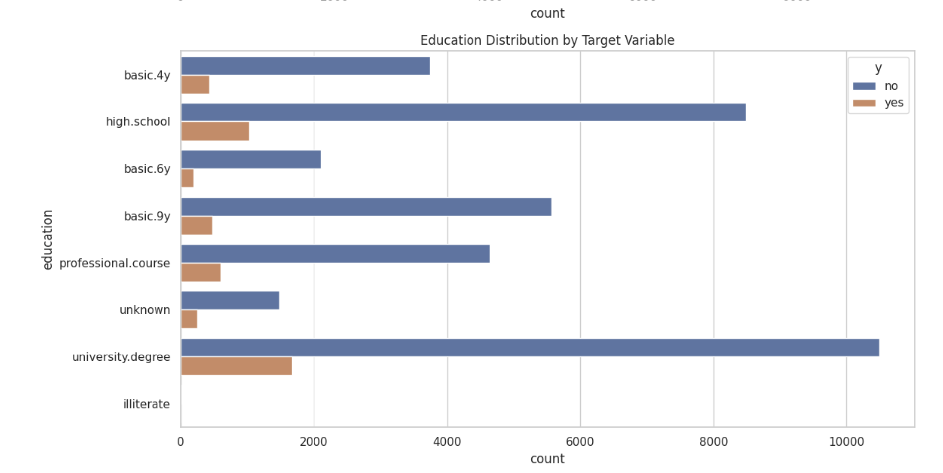
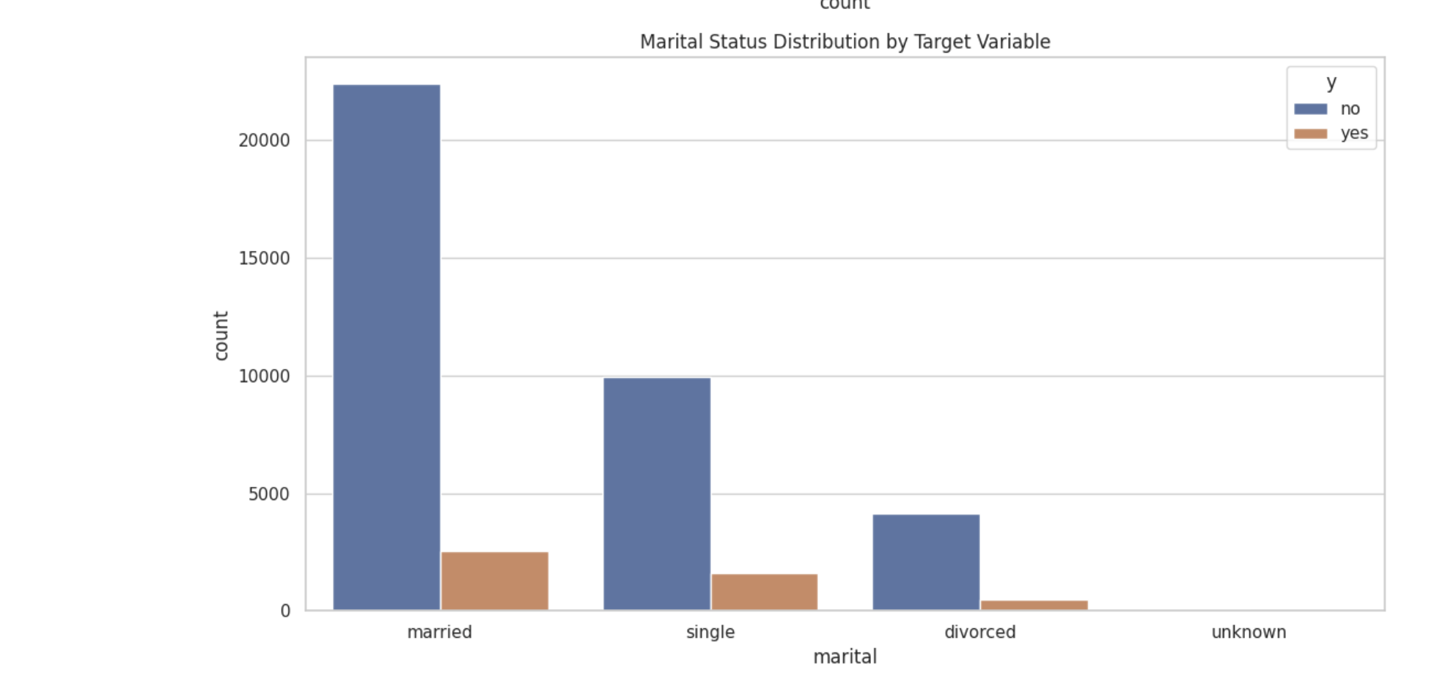
Bivariate Analysis

Slide 9

Data Pre-Processing

Slide 10
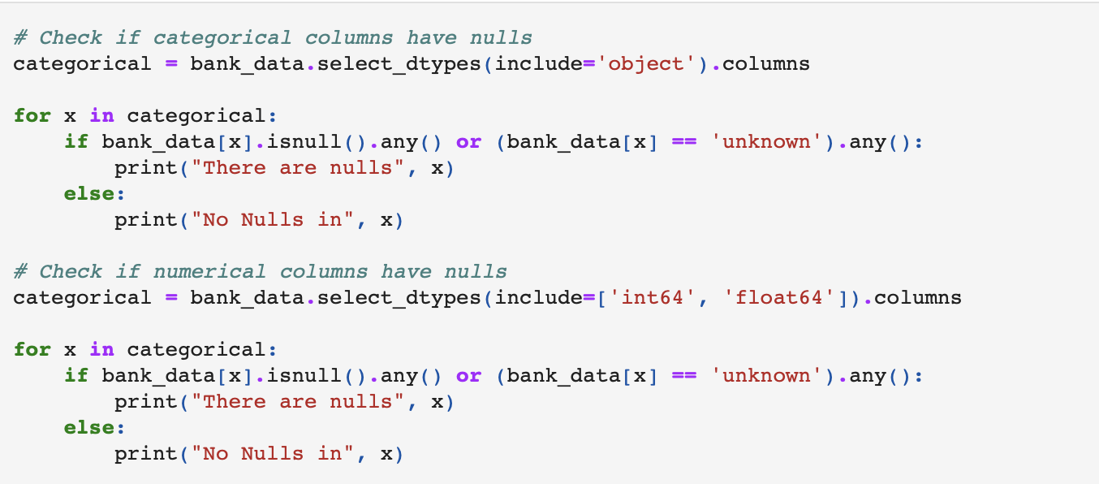
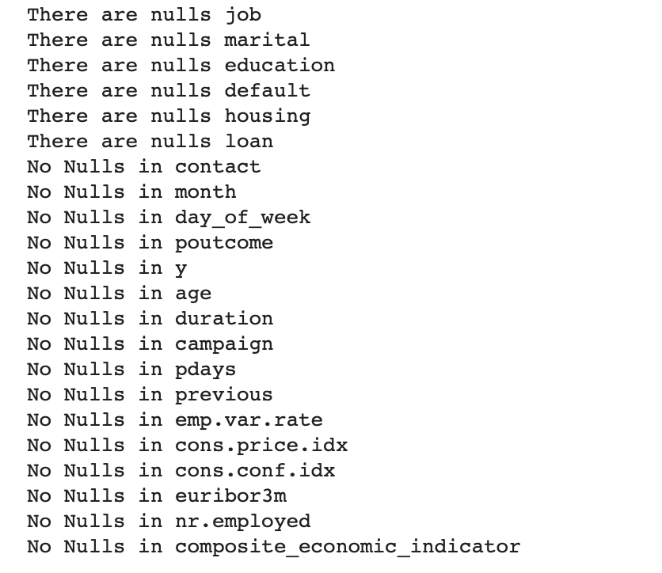
Check for Null Values

Slide 11
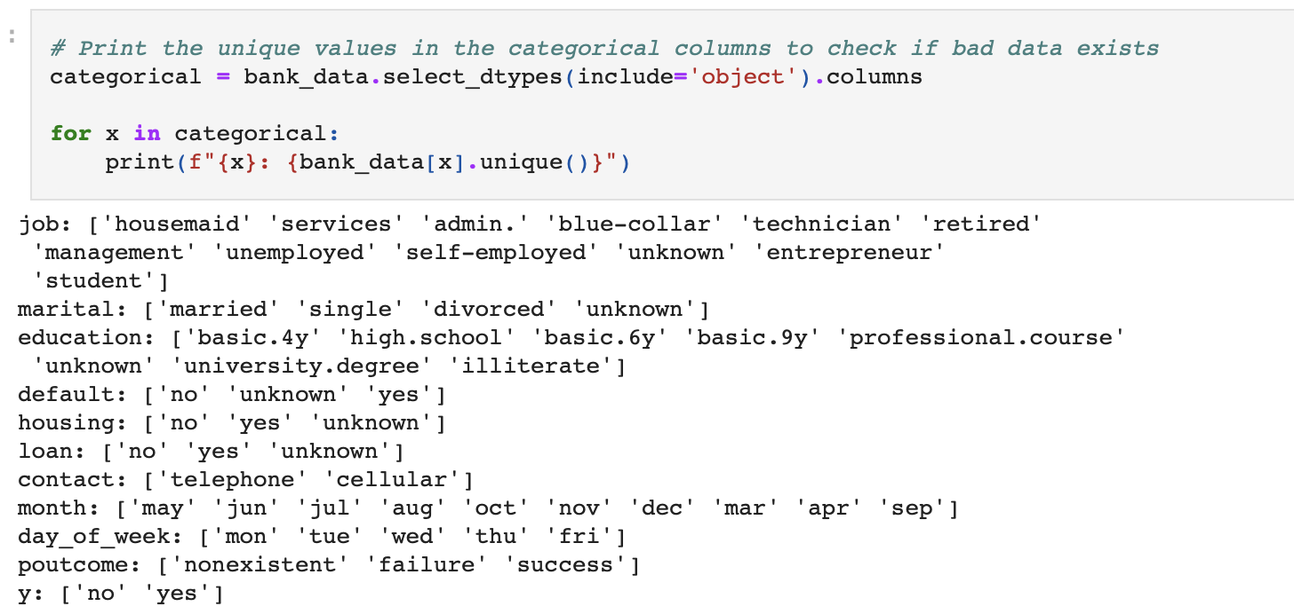
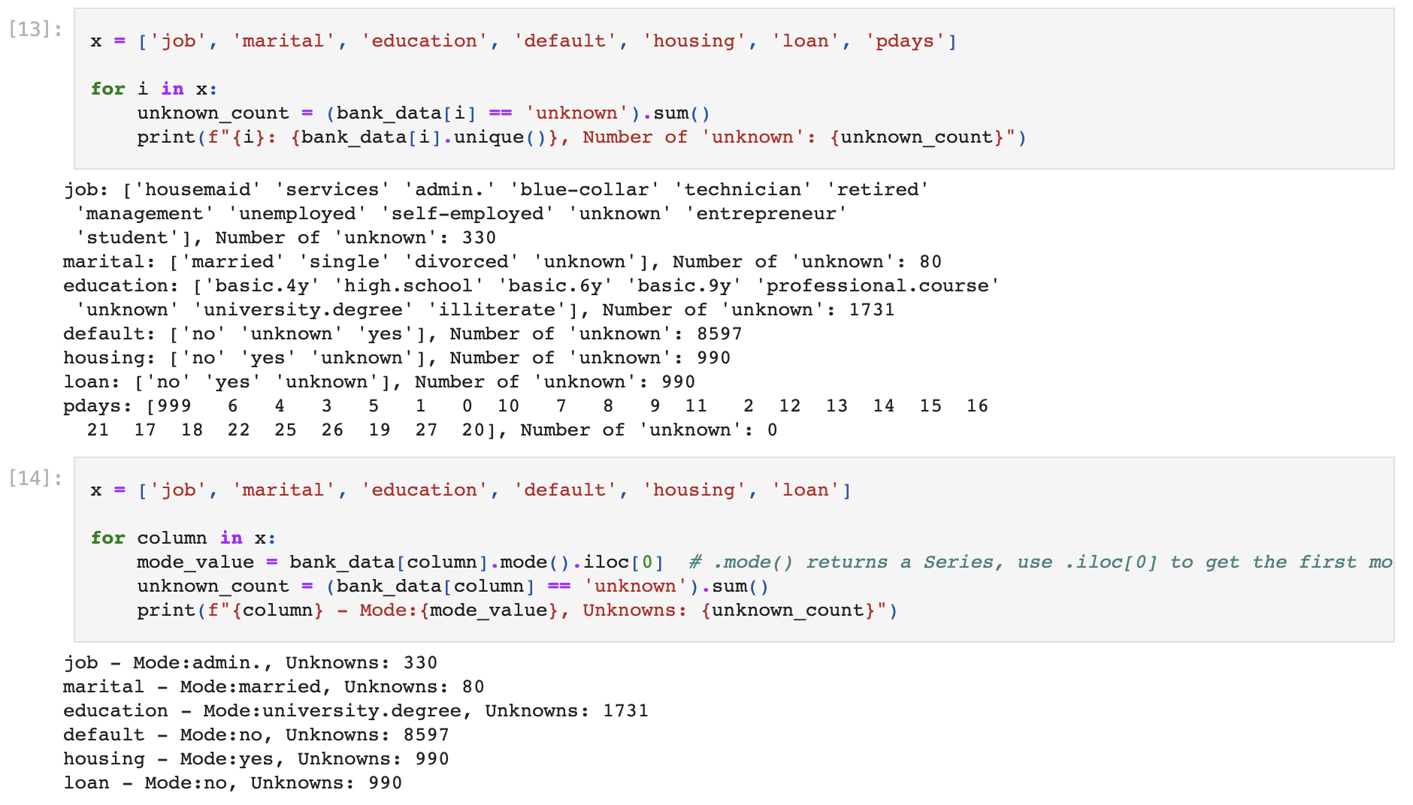
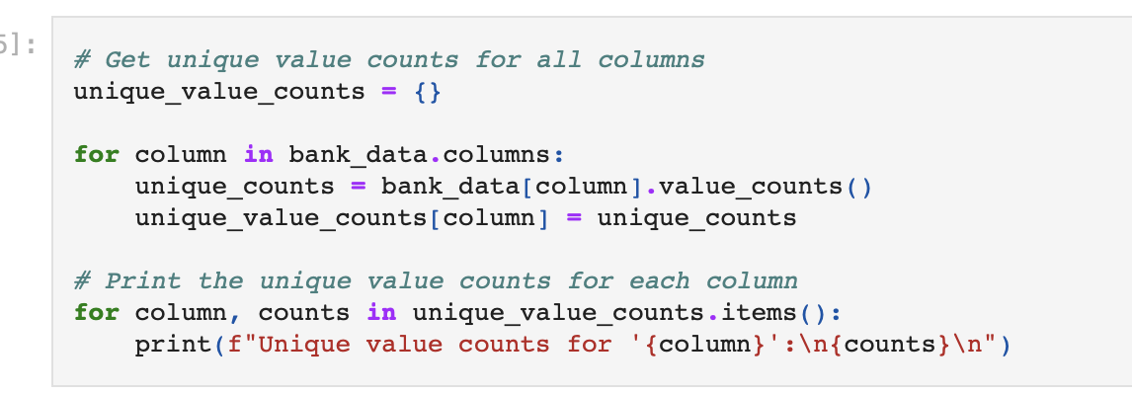
Check for Unique Values & Counting the number of Unknowns

Slide 12
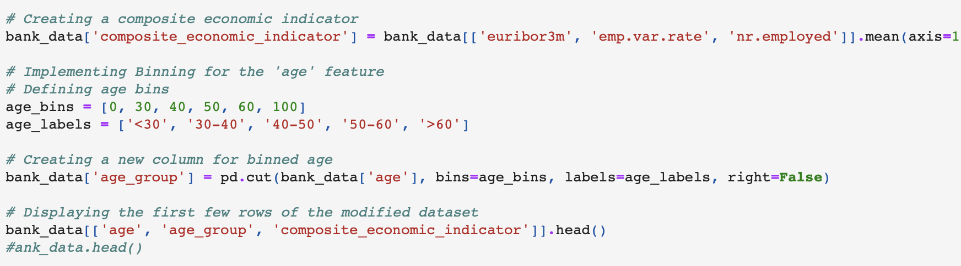
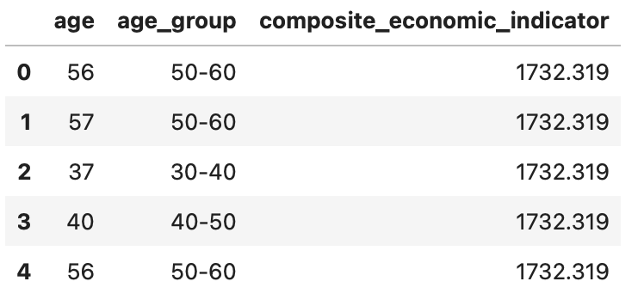
Creating a composite economic indicator
Analyzing Redundancy
euribor3m, emp.var.rate, and nr.employed: These three features are highly interrelated. Since they all are economic indicators, it's likely that they carry similar information regarding the economic condition during the time of the campaign.
cons.price.idx and emp.var.rate: Although correlated, the consumer price index (cons.price.idx) and the employment variation rate (emp.var.rate) may capture different aspects of the economy.
Analyzing Correlation Among Economic Indicators:
The high correlations among euribor3m, emp.var.rate, and nr.employed suggest that these indicators move together. This might be due to their connection to the broader economic situation, which impacts both employment and interest rates.

Slide 13
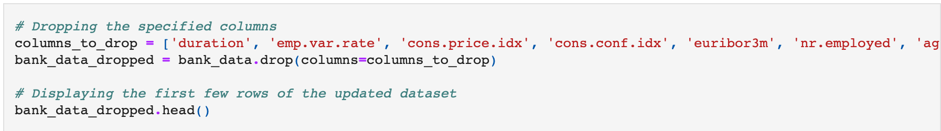
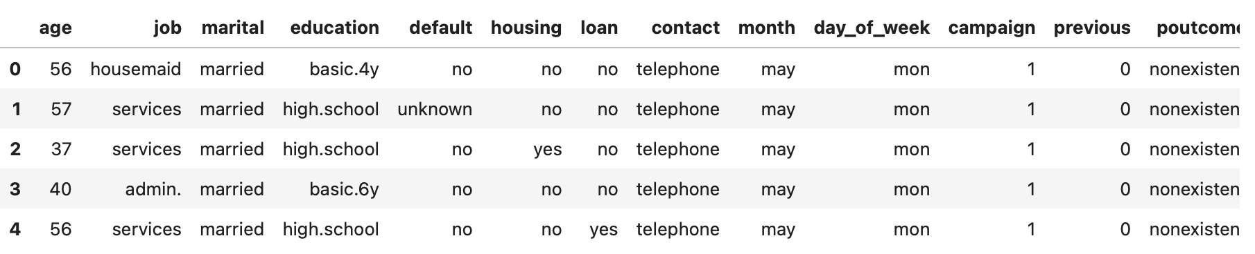
Dropping Columns

Slide 14

Feature Engineering

Slide 15
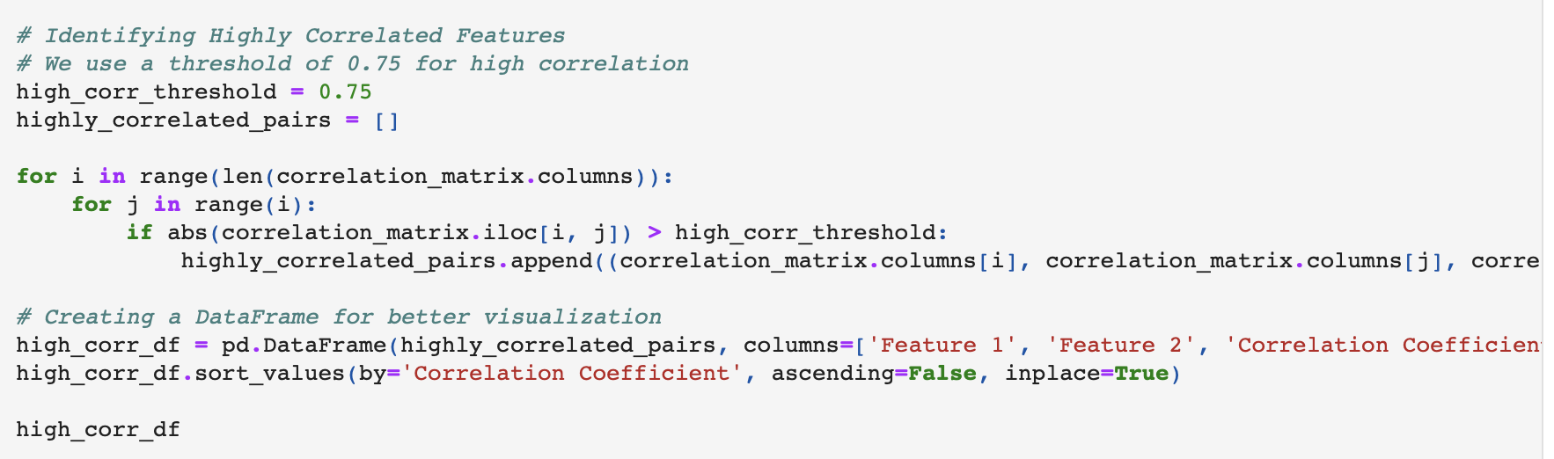
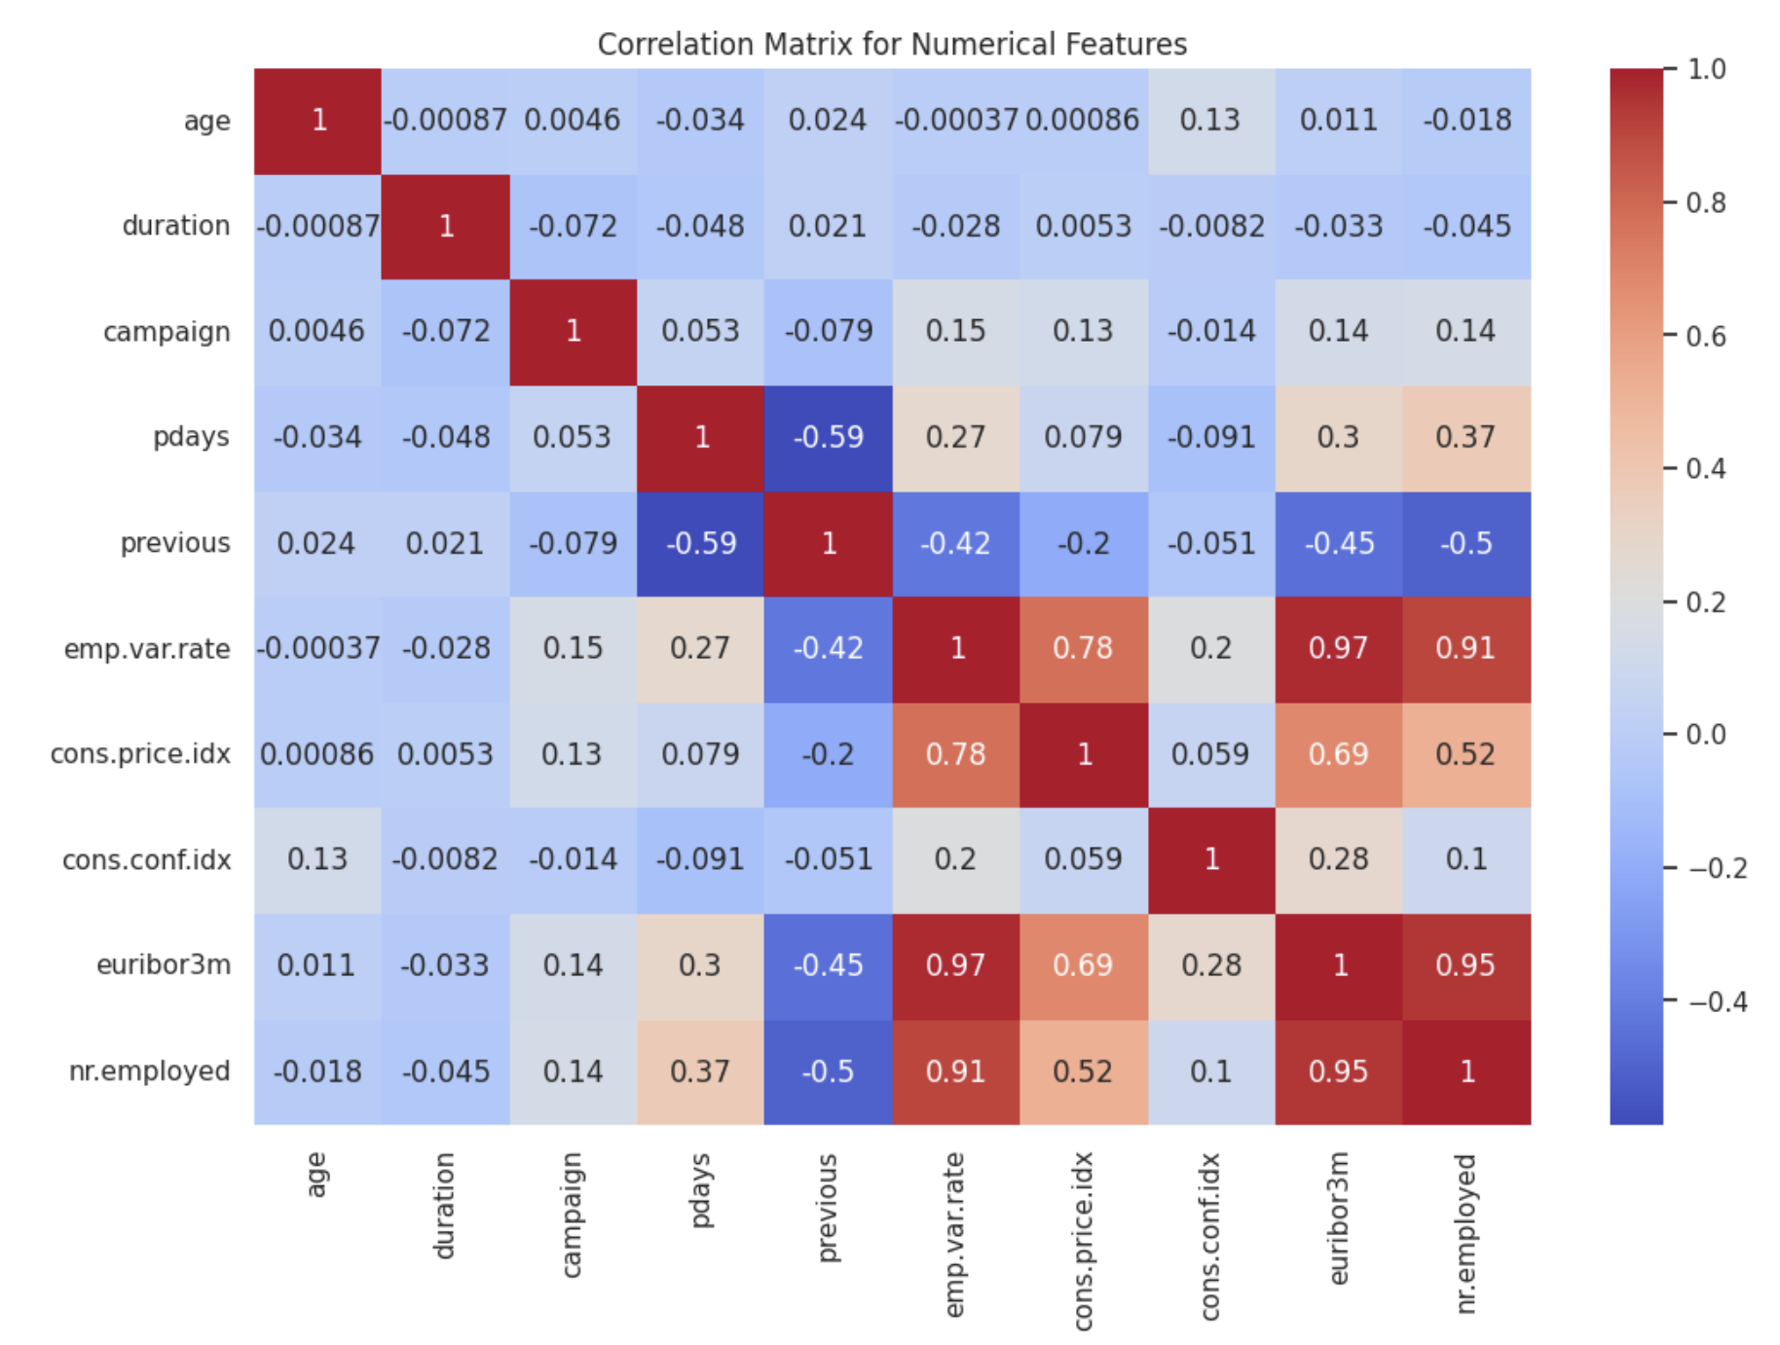
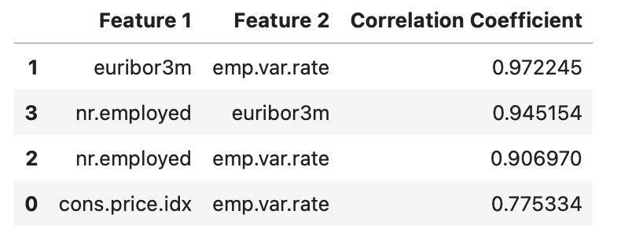
Correlation Analysis
The analysis reveals the following pairs of highly correlated features:
euribor3m and emp.var.rate with a correlation coefficient of approximately 0.97. nr.employed and euribor3m with a correlation coefficient of about 0.95. nr.employed and emp.var.rate with a correlation coefficient around 0.91. cons.price.idx and emp.var.rate with a correlation coefficient of about 0.78.

Slide 16
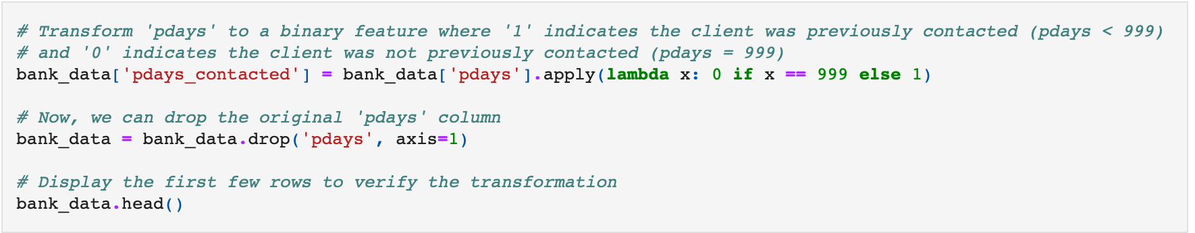
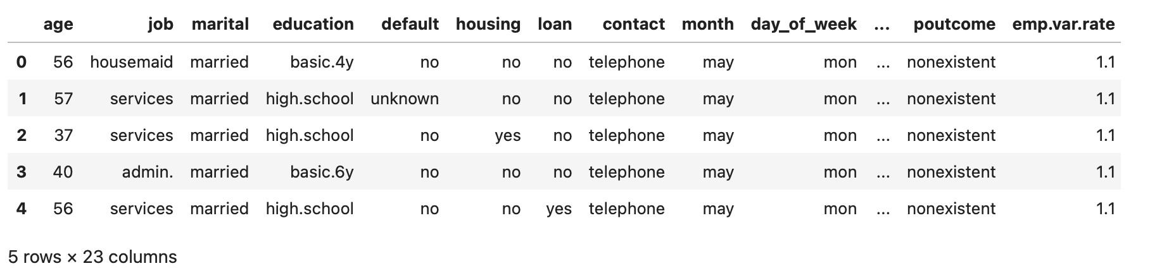
Transform ’pdays’ to a binary feature

Slide 17
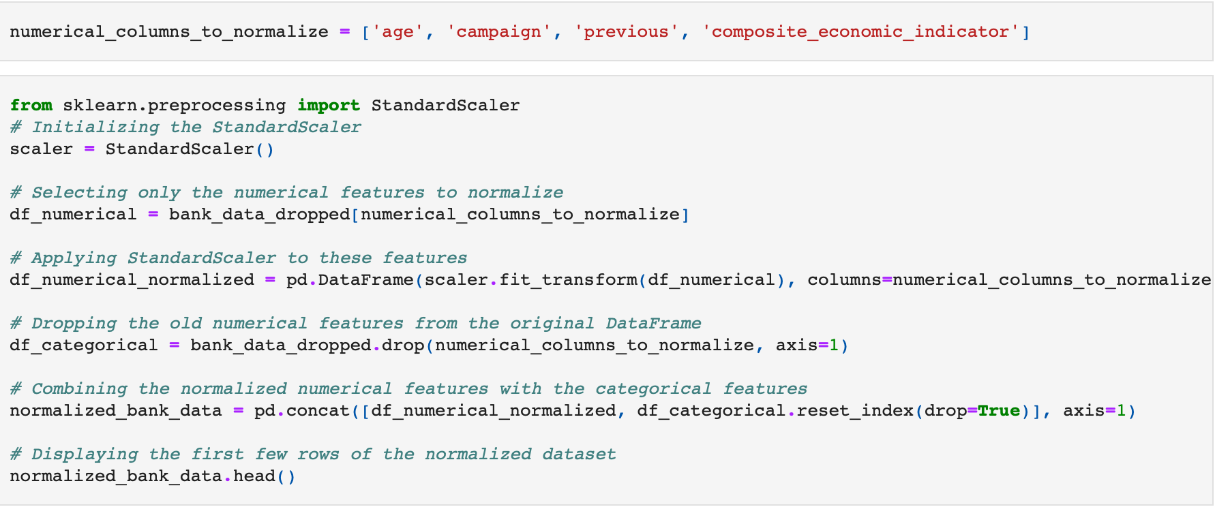
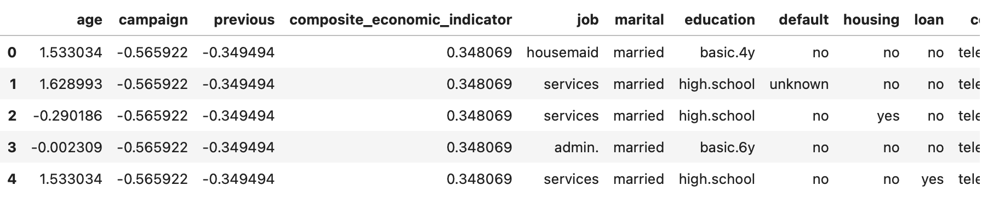
Normalizing the specified numerical features

Slide 18
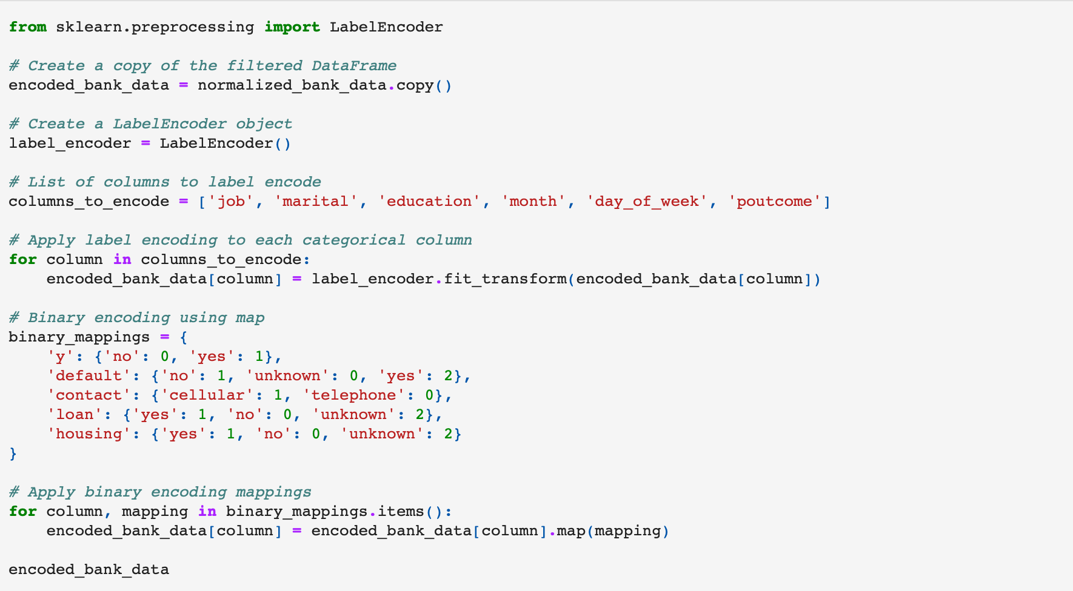
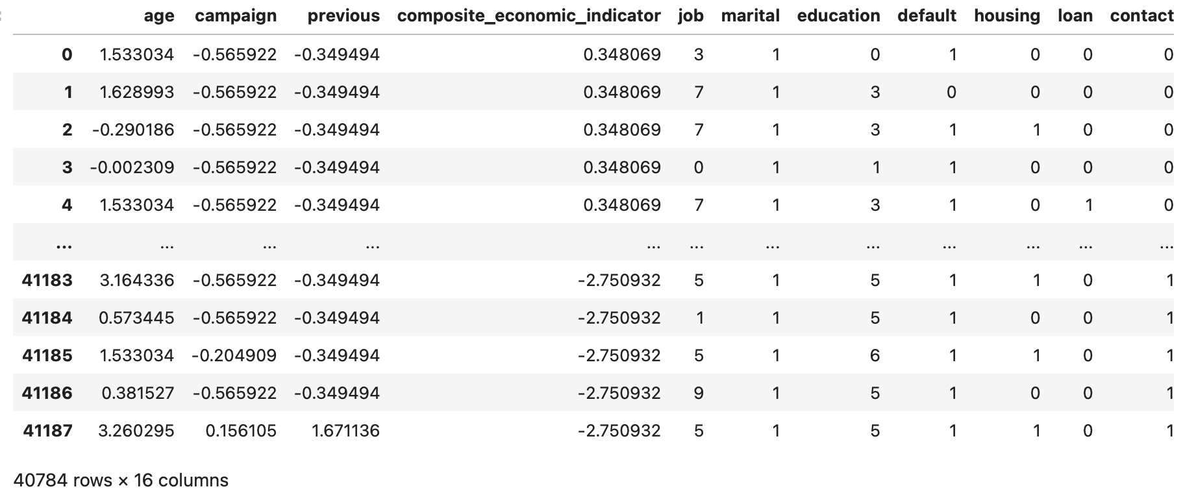
Encoding Categorical Features

Slide 19

Model Training & Evaluation

Slide 20
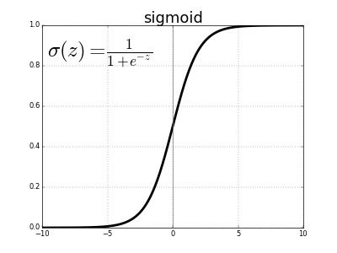
Logistic Regression
Logistic Regression is a statistical method used for binary classification problems, making it a powerful tool in predictive modeling. Unlike linear regression, which predicts continuous outcomes, logistic regression predicts the probability of an instance belonging to a particular class, typically denoted as 'yes' or 'no,' '1' or '0.' This method is well-suited for scenarios where the relationship between the independent variables and the log-odds of the dependent variable is expected to be linear. In the context of machine learning, Logistic Regression is widely employed for its simplicity, interpretability, and efficiency. It models the log-odds of the probability of the positive class through a logistic function, also known as the sigmoid function.

Slide 21
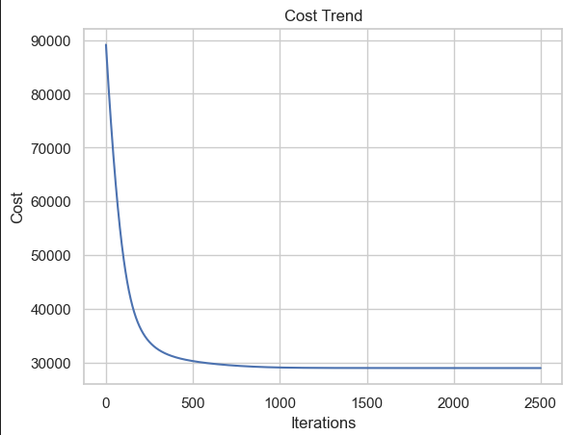
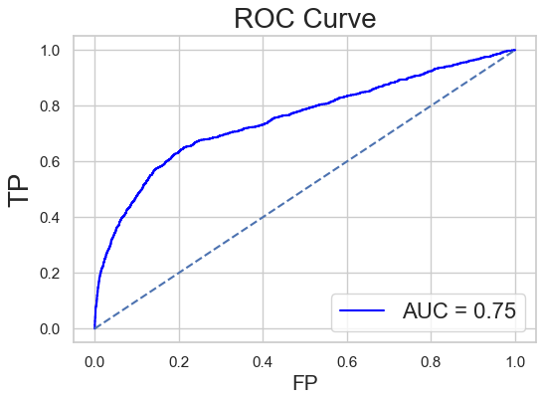
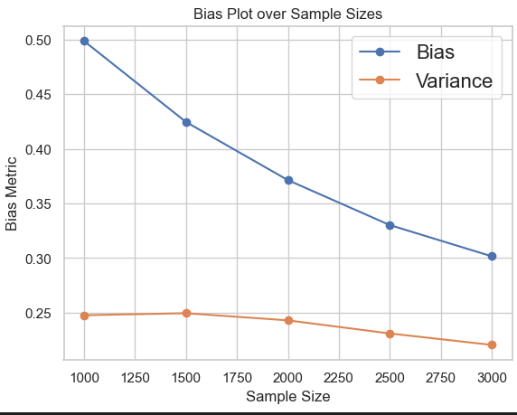

Slide 22
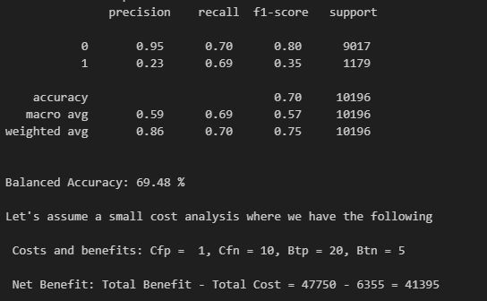
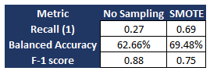
Observations:
The model achieved an accuracy of 70%, with a balanced accuracy of 69.48%. While the overall accuracy is reasonable, it's important to note the imbalanced nature of the classes, as evident from the higher accuracy for the majority class (0).
We will focus on minority class metrics – the model achieved a recall of 0.69 for minority class, an increase from 0.27 without sampling (not shown in the picture)
There was an increase in minority class recall when we adjusted the prediction threshold from 0.5 to 0.4, and this reduced the number of false negatives and increased fall positive (which fits our requirement)
The number of false negatives dropped from 858 (LOR without SMOTE) to 362, indicating that our model is doing a better job of identifying minority class true positives and thereby not losing out of crucial subscribers
The reduction in F-1 score depicts the trade-off between precision and recall
We also did KFold model evaluation and noticed these metrics to be similar without much variance in metrics indicating the model generalized

Slide 23
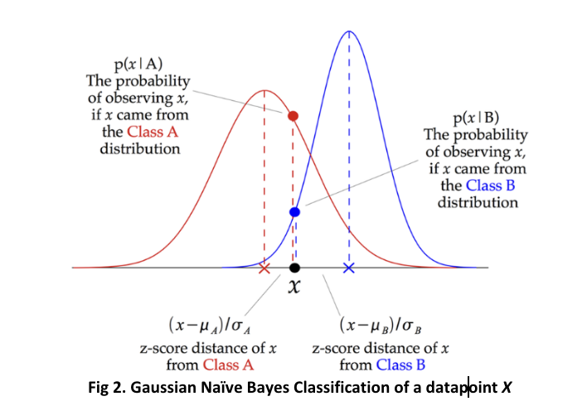
Gaussian Naïve Bayes
Gaussian Naive Bayes is a probabilistic machine learning algorithm that belongs to the family of Naive Bayes classifiers. It is particularly well-suited for classification tasks where features are continuous and assumed to have a Gaussian (normal) distribution. The algorithm is based on Bayes' theorem and makes the "naive" assumption that features are conditionally independent given the class label, which simplifies the calculation of probabilities.
While Gaussian Naive Bayes may not capture complex relationships in the data, its simplicity, efficiency, and effectiveness on certain types of data can help us understand our classification tasks, especially in situations where the independence assumption aligns with the underlying data structure.

Slide 24
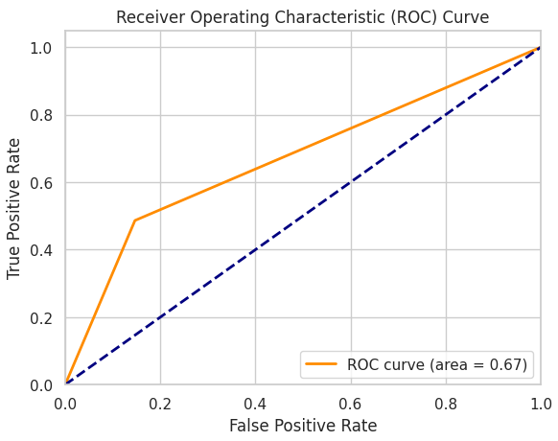
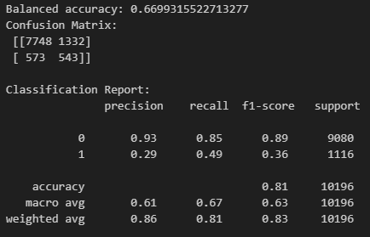
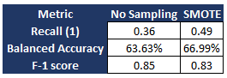
Observations:
The model achieved an accuracy of 81%, with a balanced accuracy of 66.99%. The overall accuracy was better than Logistic Regression but that doesn’t explain the entire story as we are more interested in recall for minority class
The model achieved a recall of 0.49 for minority class, an increase from 0.36 without sampling (not shown in the picture) suggesting that it could not capture intricate details like the logistic regression model
The number of false negatives dropped from 710 (GNB without SMOTE) to 573, indicating that our model is doing a better job of identifying minority class true positives but just identifying ~50% of true positives thereby losing out on half the actual subscribers
F-1 score did not change significantly
We also did KFold model evaluation and noticed these metrics to be similar without much variance

Slide 25
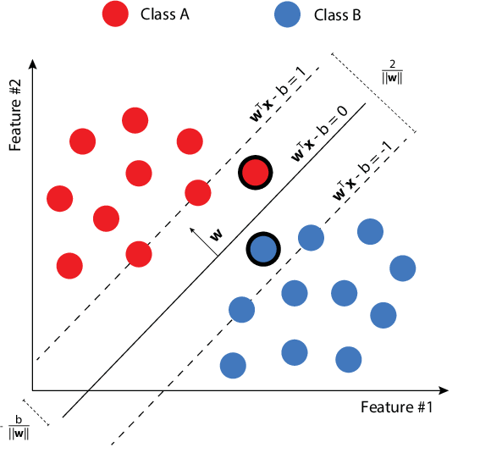
Support Vector Machines (SVM)
SVMs are a class of supervised machine learning algorithms used for classification and regression tasks. They belong to the family of discriminative classifiers and are particularly powerful in high-dimensional spaces. They are widely employed in various domains, including finance, biology, and image processing. SVMs seek to draw an optimal line, or hyperplane, in a high-dimensional space, effectively demarcating different classes within the data.

Slide 26
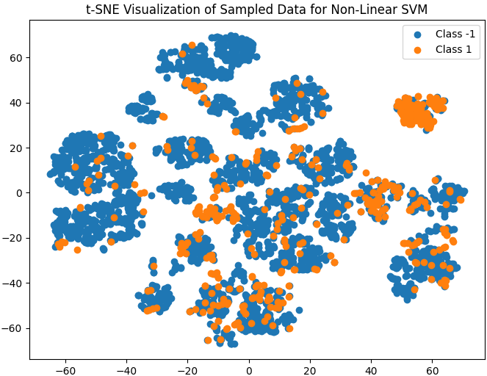
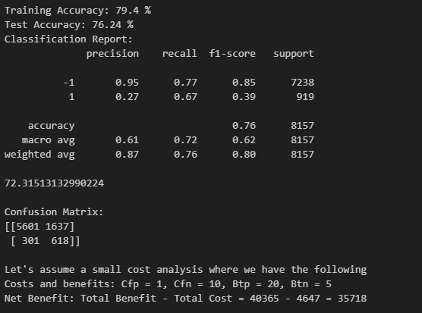
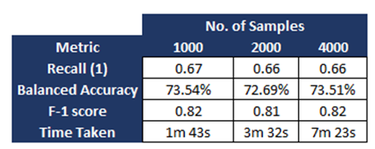
Observations:
The model achieved training accuracy of 78.4%, testing accuracy of 76.24% with a balanced accuracy of 72.31% with 500 samples each of class -1 and 1.
The model achieved a recall of 0.67 for minority class, slightly lower than Logistic Regression model
The number of false negatives were 301, indicating that our model is doing a better job of identifying minority class true positives and reducing the number of false negatives
Different values of C were tested and C>0.8 increased the training accuracy which indicated that the model was overfitting to the intricacies in the dataset as we also observed a decrease in testing accuracy

Slide 27
Conclusion

Slide 28
Enhanced Minority Class Identification: Across all models, there was a significant improvement in identifying minority class (potential subscribers), with Logistic Regression showing the highest increase in recall, thereby effectively targeting potential subscribers.
Balanced Accuracy Achievements: The models demonstrated reasonable balanced accuracy, with Logistic Regression standing out at 69.48%, indicating a strong performance in handling imbalanced class distributions.
Effective Sampling Techniques: The use of SMOTE and other resampling techniques in all models notably reduced the number of false negatives, thus enabling better identification of true positives, which is crucial for accurately predicting subscriber behavior.
Adaptive Thresholding Benefits: Adjusting the prediction threshold in Logistic Regression improved recall for the minority class, demonstrating the model's flexibility and effectiveness in optimizing for real-world applications where capturing more potential subscribers is key.
Generalization and Reliability: The KFold model evaluation indicated minimal variance in metrics across folds for all models, suggesting that the models are well-generalized and reliable for practical use in predicting customer subscription tendencies in bank marketing scenarios.

Slide 29
References
https://archive.ics.uci.edu/dataset/222/bank+marketing
https://github.com/theamiteshtripathi/BankMarketingSegmentation
https://towardsdatascience.com/a-short-tutorial-on-naive-bayes-classification-with-implementation-2f69183d8ce1
https://www.researchgate.net/publication/228845263_An_Empirical_Study_of_the_Naive_Bayes_Classifier
https://link.springer.com/article/10.1007/BF00994018
http://deeplearning.stanford.edu/tutorial/supervised/LogisticRegression/

Slide 30

Thank You
Questions & Suggestions are welcome!
https://www.linkedin.com/in/meetvasani/
01
https://www.linkedin.com/in/srinivas-m97
02
https://www.linkedin.com/in/jaimeenunagar/
03
https://www.linkedin.com/in/theamiteshtripathi/
04
https://www.linkedin.com/in/grohitkumar/
05
Connect with collaborators

